Slide 1
Breast Cancer Data Analysis TCGA-BRCA
Members:
Andrea Bustos Alarcón
Jeniffer Funez Paisano
Miguel Ángel Naranjo

Slide 2
Diapositiva de análisis de proyecto 2
TGCA-BRCA
1. DATA DOWNLOAD
2. DATA PREPROCESSING
PROYECTO
3. EDA
4. DA
5. ANALYSIS

Slide 3
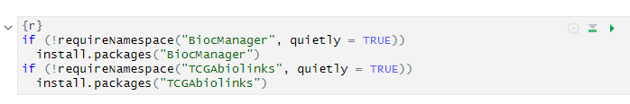

1. DATA DOWNLOAD
We started by downloading the following bibles.

Slide 4
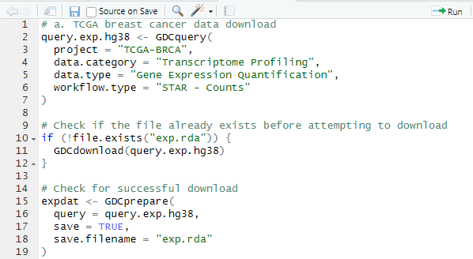
1. DATA DOWNLOAD
We continue with the download of the dataset of TCGA-BRCA.

Slide 5
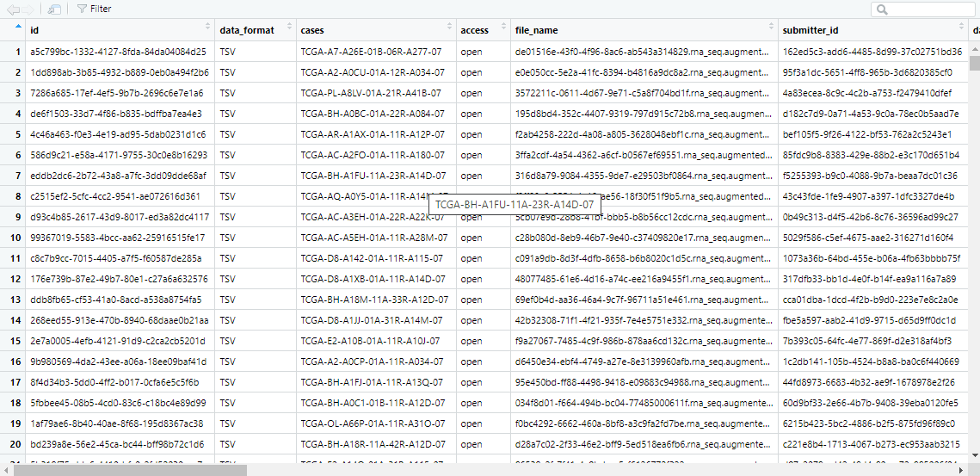
1. DATA DOWNLOAD
The following data are obtained.

Slide 6
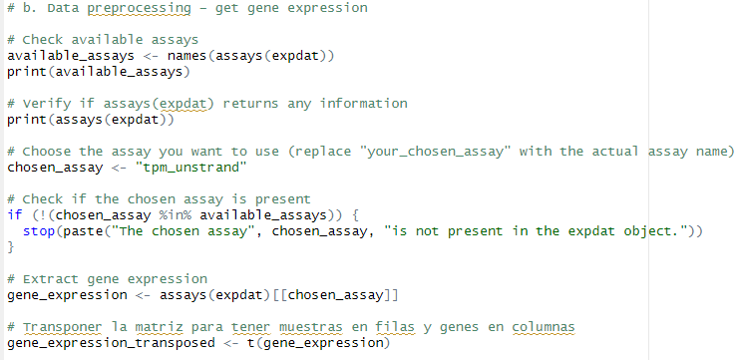
2. DATA PREPROCESSING
The next step is to obtain the gene expression to be developed during the project.
The following code is used to filter the genes.

Slide 7
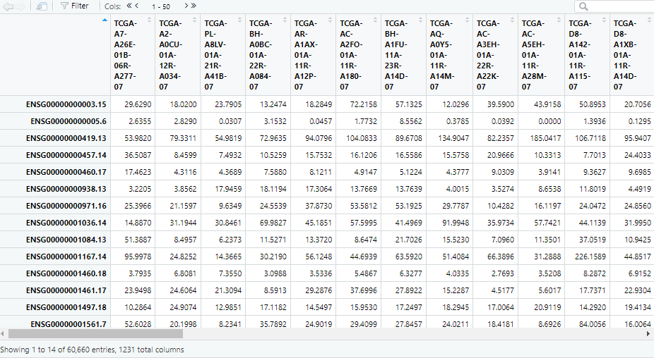
2. DATA PREPROCESSING
The following data are obtained, samples in rows and genes in columns.

Slide 8

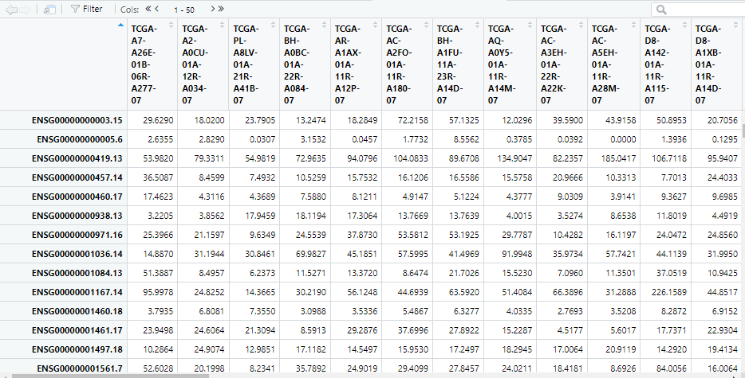
2. DATA PREPROCESSING
Gene expression continues to be filtered by eliminating any gene that is expressed in at least 20% of the samples.
The following code is used.

Slide 9

2. DATA PREPROCESSING
Continuing with the analysis, the columns will be renamed to keep only the Ensembl ID data (Genes without decimals).The following code is generated.

Slide 10
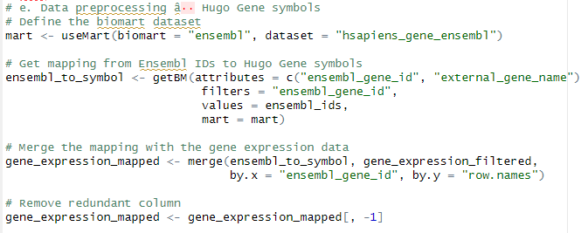
2. DATA PREPROCESSING
We continue changing the name of the Ensembl ID columns to Hugo Symbol. The following code is generated and the following library is installed.

Slide 11
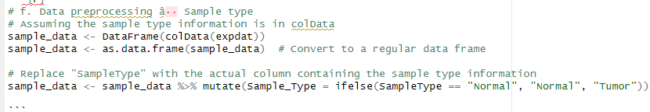
2. DATA PREPROCESSING
It is used dplyr to include a new variable containing the sample type.

Slide 12
2. DATA PREPROCESSING
Any specimen that is not normal tissue or primary tumor is removed.
The following code is generated.

Slide 13
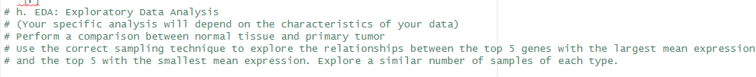
3. EDA
An exploratory analysis is performed to describe the current data set.

Slide 14
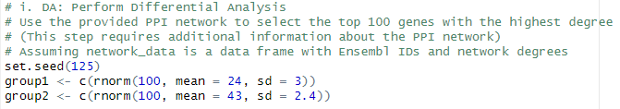
4. DA
The PPI network is used to select 100 genes with the highest degree in the network.

Slide 15
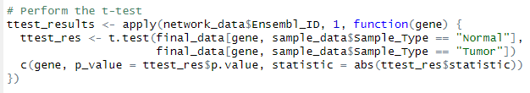
5. ANALYSIS
¿How many genes are differentially expressed between normal and cancer?

Slide 16
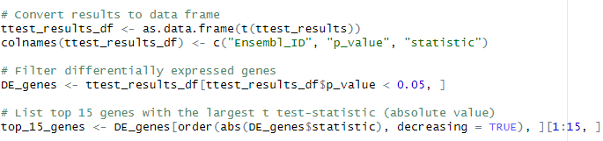
5. ANALYSIS
¿Which genes are up-regulated and which are down-regulated?

Slide 17
Thank you

